Slide 1

Earnest Builders
Premium Plots | Luxurious Flats |
Exquisite Villas

Slide 2
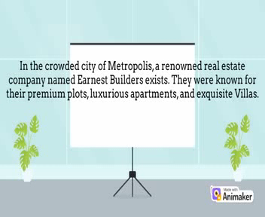

Slide 3



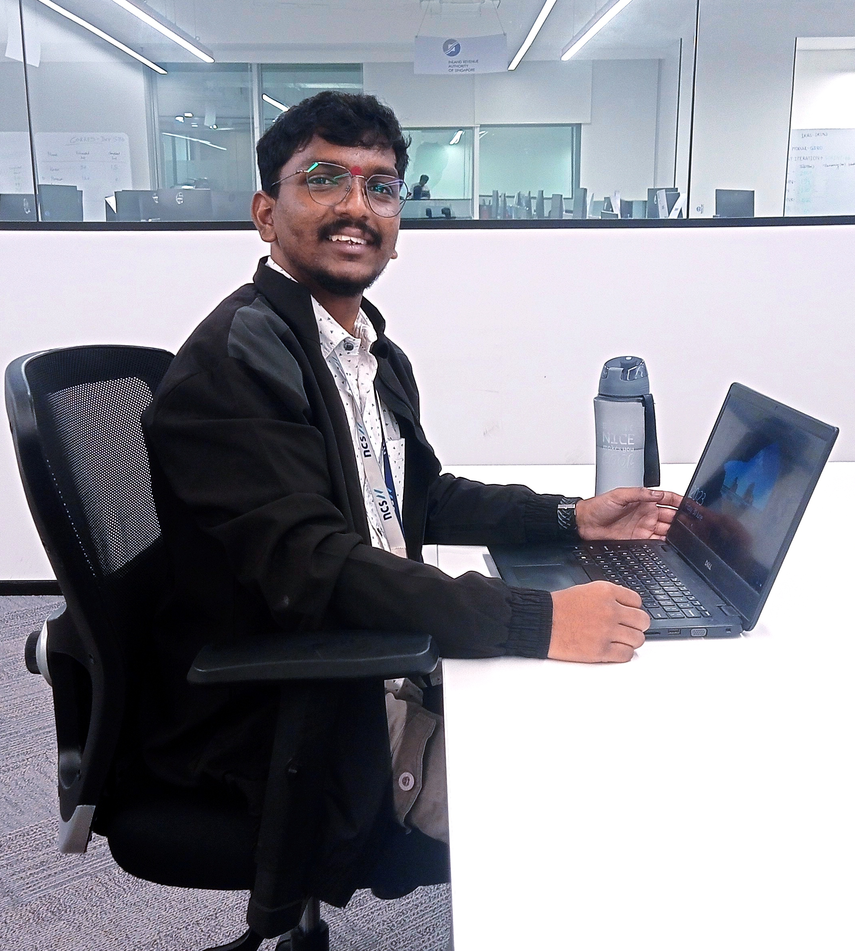
Team Members
Sachin Kokare
Amit Kumar
Deepak Ghadge
Prasad Nijai

Slide 4
Challenges Faced Previously
”
”
”
”
Manual Process: The current process of browsing through offerings and physically calling the company to book property visiting slots is time-consuming and requires manual effort.
Lack of Convenience: User must visit the company's premises or make phone calls to book property visiting slots, which may not be feasible for everyone.
Limited Market Reach: The reliance on physical browsing and phone calls restricts the company's market reach. Potential customers who are not located in close proximity or prefer online interactions may not engage with Earnest Builders, limiting their potential customer base.
Inefficient Communication: The reliance on phone calls for booking property visits can result in communication inefficiencies. Users may face challenges in reaching the company's representatives, and the company may struggle to handle a large number of phone inquiries effectively.

Slide 5
Solutions
”
”
”
”
”
View Properties and Scheduled Tours: We are providing platform for agents to view properties and scheduled tours of the properties which are assigned to them.
Centralized Property Listings: We created a user-friendly platform that showcases all the properties offered by Earnest Builders in one place. Clients can easily access and browse through the available plots, apartment flats, and villas.
Detailed Property Information: Each property listing includes comprehensive information, including high-quality images, property specifications, amenities, pricing details, and location. Clients can make informed decisions by accessing all the necessary information on the platform.
Online Tour Booking System: Our solution includes an integrated online booking system. Clients can easily schedule property visits through the platform without the need for physical visits or phone calls. They can view available visiting slots for each property, choose a convenient time, and book the slot instantly.
Add/Update/Delete Property Details: We are providing platform for admin/agency to add/update/delete property details as per their need.

Slide 6



USER STORIES
”
”
”
As a user, I want to be able to view the available properties.
As a user, I want to have the ability to filter properties based on my preferences .
As a user, I want to be able to add properties to my Wishlist.
As a user, I want to be able to schedule a visit to a property at a specific time slot.
As a user, I want to have the option to request a consultation with a real estate expert.
As an admin, I want to be able to add, update, delete, and view properties.
As an admin, I want to view the booked slots for properties.
As an admin, I want to view consultations related to properties.
As an admin, I want to add, update, delete, and view agent details.
As an admin, I want to add featured properties.
As an admin, I want to add carousel properties.
As an agent, I want to be able to view all the properties that have been assigned to me.
As an agent, I want to be able to view the tour slots of properties that have been assigned to me.

Slide 7







Architecture
Microservices
Eureka Service
Angular
API Gateway
Microservices

Slide 8
Microservices

Slide 9
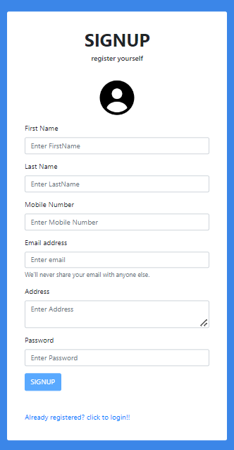
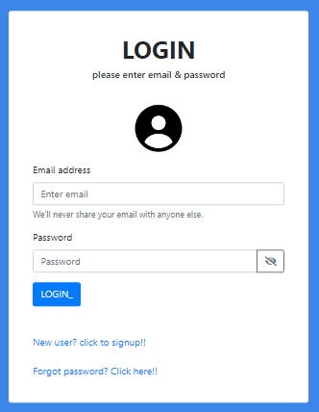










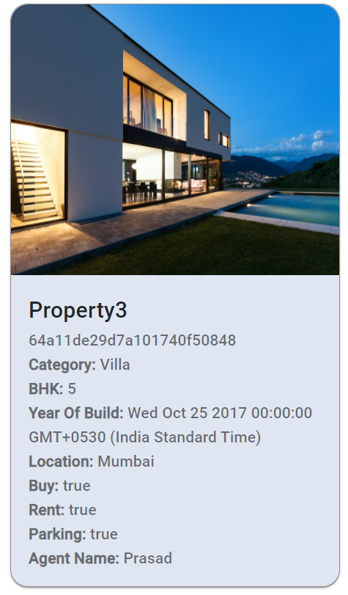




Register Microservice
Login
Microservice
Property
Microservice
Agent
Microservice
Feign Client
Angular
Eureka Service
Schedule Tour
Microservice
API Gateway
Consultation
Microservice
Wishlist
Microservice
Carousel
Microservice
Featured Property
Microservice

Slide 10
Quick Demo

Slide 11

Database Selection

Slide 12
MySQL
Register Microservice
Login
Microservice
Feign Client
Angular
Eureka Service
API Gateway

Slide 13
Mongo DB
Property
Microservice
Agent
Microservice
Angular
Schedule Tour
Microservice
Eureka Service
API Gateway
Consultation
Microservice
Wishlist
Microservice
Carousel
Microservice

Slide 14
RDS
Angular
Eureka Service
API Gateway
Featured Property
Microservice

Slide 15
Dataflow Diagram
How the data is coming.

Slide 16

`
Register MS
Login Service
(Consumer MS)
Rest Controller
Mongo Repository
Rest Controller
CRUD Operations
<<interface>> Login Service
CRUD Operations
MongoDB
Angular Client
Feign Client
Register Service Proxy

Slide 17
01
Detailed Demo

Slide 18
02
Detailed Demo

Slide 19


Microservices Pattern
Eureka Server
API-Gateway

Slide 20
Eureka Server
Microservices
(Eureka Client)
Schedule Tour
Microservice
Featured Property
Microservice
Register Microservice
Login
Microservice
Property
Microservice
Agent
Microservice
Consultation
Microservice
Wishlist
Microservice
Carousel
Microservice
Eureka Server

Slide 21
API- Gateway

Slide 22

Register Microservice
Login
Microservice
Property
Microservice
Agent
Microservice
Feign Client
Angular
API Gateway
Schedule Tour
Microservice
Consultation
Microservice
Wishlist
Microservice
Carousel
Microservice
Featured Property
Microservice

Slide 23
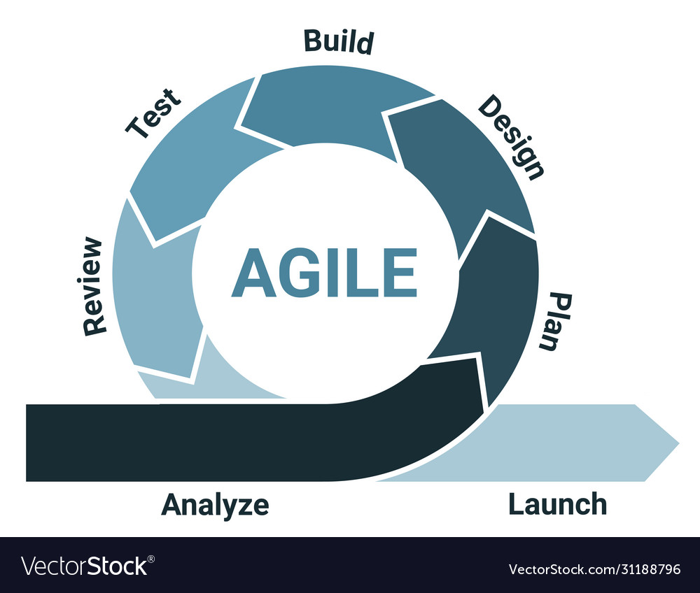
Agile Methodology

Slide 24
Revenue
We will show advertisements on website in order to get online revenue.
User can subscribe to our premium service to get first priority on booking and sale on properties.
User can subscribe to news letter to get notification of upcoming properties or newly launched properties.
User can subscribe to our premium to get more detailed consultation of properties.

Slide 25
Product Backlog
We will provide option for user to postpone or delete any booked slot
We will provide option for agent to delay booked slot
We will enhance consultation portal as chat portal.

Slide 26





Technologies Used
Frontend:
Backend:
Database and Deployment

